Slide 1
Chapter 2
Database System Concepts and Architecture

Slide 2
Chapter 2 Outline
Data Models, Schemas, and Instances
Three-Schema Architecture and Data Independence
Database Languages and Interfaces
The Database System Environment
Centralized and Client/Server Architectures
for DBMSs
Classification of Database Management Systems

Slide 3
Basic client/server DBMS architecture
Basic client/server DBMS architecture
  Client module
  Server module

Slide 4
Data abstraction
Abstraction, in general, is the process of highlighting of the essential features for an improved understanding of data.
  only essential information about the data to the outside world, hiding the background details or implementation
Data abstraction is usually the first step in database design.
A complete database is too complex to be developed without first creating a simplified framework.

Slide 5
Data Model
A collection of concepts that can be used to describe the structure of a database which provides the necessary means to achieve the abstraction
By structure of a database we mean the data types, relationships, and constraints that apply to the data
Most data models also include a set of basic operations for specifying retrievals and updates on the database

Slide 6
Categories of Data Models
High-level (or Conceptual data models)
  User level data model is the high level or conceptual model. This provides concepts that are close to the way that many users perceive data
Low-level (or Physical data models)
  Describe the details of how data is stored on computer storage
    Low level data model is only for computer specialists not for end-user
Representational data models (or relational)
  It is between High level & Low level data model
  Similar to how data organized in computer storage
Notes:
Conceptual data model hides the internal details of physical storage and targets on describing entities, datatype, relationships and constraints.

Slide 7
Categories of Data Models (cont'd.)
Entity
  Represents a real-world object or concept
Attribute
  Represents some property of interest
  Further describes an entity
Relationship among two or more entities
  Represents an association among the entities
  Entity-Relationship model
Notes:
Student is an Entity ,, StudentName is an Attribute
Relationship between Student and Course, for example.

Slide 8
Categories of Data Models (cont'd.)
Relational data model
  Used most frequently in traditional commercial DBMSs
Object data model
  New family of higher-level implementation data models
  Closer to conceptual data models (high level)
Notes:
The SQL standard for relational databases will be discussed in Chapters 4 and 5

Slide 9
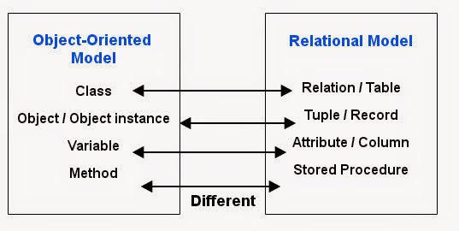
Categories of Data Models (cont'd.)
Notes:
Object Oriented Data Model vs Relational Data Model

Slide 10
Categories of Data Models (cont'd.)
Physical data models
  Describe how data is stored as files in the computer
  Access path
    Structure that makes the search for particular database records efficient
  Index
    Example of an access path
    Allows direct access to data using an index term or a keyword

Slide 11
Database Schemas
Database schema
  Description of a database (which is specified during database design and is not expected to change frequently).
Schema diagram
  Displays selected aspects of schema. Most data models have certain conventions for displaying schemas as diagrams.
Schema construct
  Each object in the schema e.g. STUDENT or COURSE
Database state or snapshot
  Data in database at a particular moment in time

Slide 12
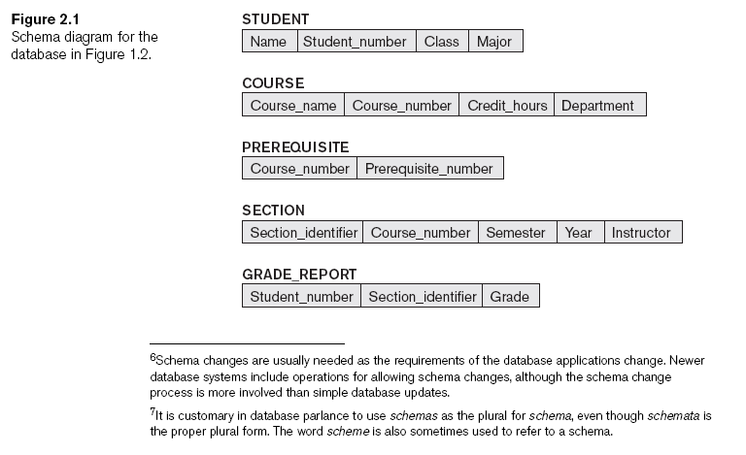
Schema diagram
Notes:
Schema diagram for the database in Figure 1.2

Slide 13
Database States
Define a new database
  Specify database schema to the DBMS
Initial state
  Populated or loaded with the initial data
Valid state
  Satisfies the structure and constraints specified in the schema
Notes:
Types of constraints:
-A NOT NULL constraint is a rule that prevents null values from being entered into one or more columns within a table.
-A unique constraint is a rule that forbids duplicate values in one or more columns within a table.
-A primary key constraint is a column or combination of columns that has the same properties as a unique constraint
-A foreign key constraint is a logical rule about values in one or more columns in one or more tables

Slide 14
Schema Evolution
Schema evolution
  Changes applied to schema as application requirements change

Slide 15
Three-Schema Architecture
Internal level
  Describes the complete details of data storage and access paths for the database
Conceptual level
  Describes structure of the whole database for a community of users
  Hides the details of physical storage structures and concentrates on describing entities, data types, relationships, and constraints
External or view level
  Describes part of the database that a particular user group is interested in (view)
Notes:
The internal schema uses a physical data model and describes the complete details of data storage and access paths for the database
Physical data independence deals with hiding the details of the storage structure from user applications

Slide 16
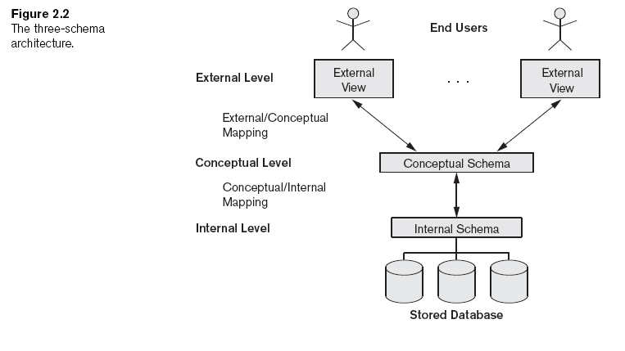
Three-Schema Architecture (cont'd.)
Part of the database that a particular user group is interested in
structure of the whole database
physical storage structure

Slide 17
Data Independence
Capacity to change the schema at one level of a database system
  Without having to change the schema at the next higher level
Logical is the capacity to change the conceptual schema without having to change external schemas or application programs
Physical is the capacity to change the internal schema without having to change the conceptual schema
Notes:
Types: Logical and Physical

Slide 18
DBMS Languages
Data definition language (DDL)
  Defines both schemas (Internal and Conceptual)
  Examples : create, alter, and drop schema
Storage definition language (SDL)
  Specifies the internal schema
  Examples: Initrans, pctfree
View definition language (VDL)
  A language that supports the definition of external views of a DB
  Example : create view
Data manipulation language (DML)
  Allows retrieval, insertion, deletion, modification
  Examples : delete, Insert, update, select
Notes:
The INITRANS setting controls Initial Transaction Slots (ITLs). A transaction slot is required for any session that needs to modify a block in an object.
PCTFREE is a block storage parameter used to specify how much space should be left in a database block for future updates

Slide 19
DBMS Languages (cont'd.)
High-level or nonprocedural DML
  Can be used on its own to specify complex database operations concisely
Low-level or procedural DML
  Must be embedded in a general-purpose programming language and It needs to use programming language constructs, such as looping, to retrieve and process each record from a set of records.
  This type of DML typically retrieves individual records or objects from the database and processes each separately.
  Low-level DMLs are also called record-at-a-time DMLs
Notes:
There are two main types of DMLs. A high-level or nonprocedural and A low- level or procedural

Slide 20
DBMS Interfaces
Menu-based interfaces for Web clients or browsing:
  Menus do away with the need to memorize the specific commands and syntax of a query language
Forms-based interfaces:
  Forms-based interface displays a form to each user. Users can fill out all of the form entries to insert new data
Graphical user interfaces
  A GUI typically displays a schema to the user in diagrammatic form. The user then can specify a query by manipulating the diagram
Natural language interfaces
  These interfaces accept requests written in English or some other language and attempt to understand them

Slide 21
DBMS Interfaces (cont'd.)
Speech input and output
  e. g. Telephone directory, flight arrival/departure, and credit card account information are allowing speech for input and output to enable customers to access this information
Interfaces for parametric users
  Such as bank tellers, often have a small set of operations that they must perform repeatedly, such as account deposits or withdrawals, or balance inquiries (or ATM)
Interfaces for the DBA
  Most database systems contain privileged commands that can be used only by the DBA staff. These include commands for creating accounts, setting system parameters, granting account authorization, changing a schema, and reorganizing the storage structures of a database.

Slide 22
The Database System Environment
DBMS component modules
  Buffer management
  Stored data manager
  DDL compiler
  Interactive query interface
    Query compiler
    Query optimizer
  Precompiler
Notes:
The Query optimizer attempts to determine the most efficient way to execute a given query by considering the possible query plans

Slide 23
The Database System Environment (cont'd.)
DBMS component modules
  Runtime database processor
  System catalog
  Concurrency control system
  Backup and recovery system

Slide 24
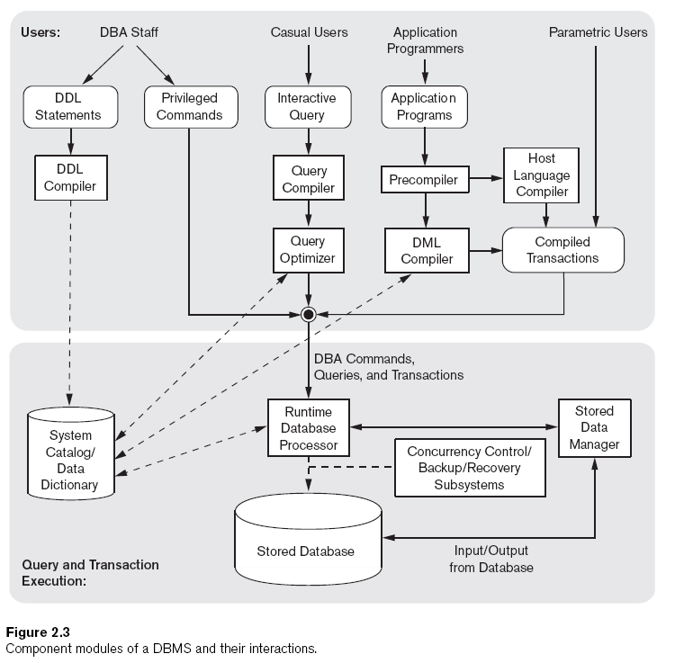
Notes:
Component modules of a DBMS and their interactions.
A Data Dictionary/System Catalog is closely coupled with the DBMS software
The Query optimizer attempts to determine the most efficient way to execute a given query by considering the possible query plans

Slide 25
Database System Utilities
Loading
  Load existing data files
Backup
  Creates a backup copy of the database; usually by dumping the entire database onto tape or other mass storage medium
Notes:
SQL file – Import and Export in MySQL

Slide 26
Database System Utilities (cont'd.)
Database storage reorganization
  Reorganize a set of database files into different file organizations
Performance monitoring
  Monitors database usage and provides statistics to the DBA

Slide 27
Application Environments
Data dictionary (data repository) system
  Stores design decisions, usage standards, application program descriptions, and user information

Slide 28
Centralized and Client/Server Architectures for DBMSs
Centralized DBMSs Architecture
  All DBMS functionality, application program execution, and user interface processing carried out on one machine

Slide 29
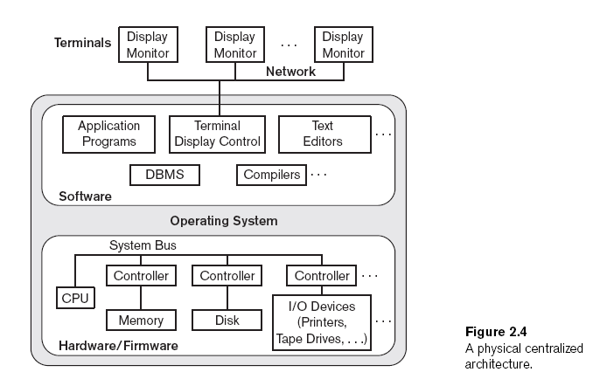
Notes:
A Physical centralized architecture

Slide 30
Basic Client/Server Architectures
Servers with specific functionalities
  File server
    Maintains the files of the client machines.
  Printer server
    Connected to various printers; all print requests by the clients are forwarded to this machine
  Web servers or e-mail servers

Slide 31
Basic Client/Server Architectures (cont'd.)
Client machines
  Provide user with:
    Appropriate interfaces to utilize these servers
    Local processing power to run local applications

Slide 32
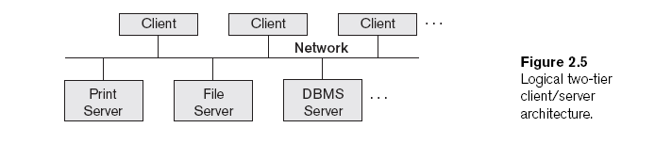
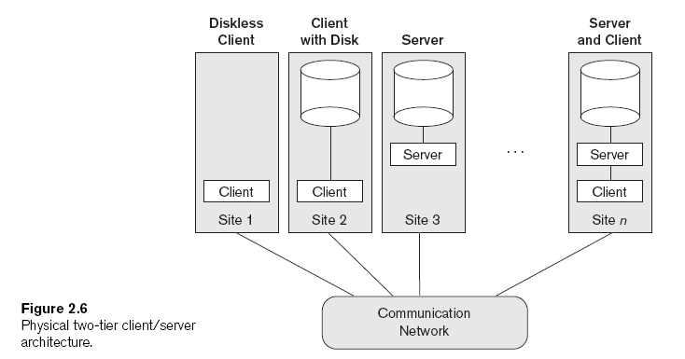

Slide 33
Basic Client/Server Architectures (cont'd.)
Client
  User machine that provides user interface capabilities and local processing
Server
  System containing both hardware and software
  Provides services to the client machines
    Such as file access, printing, archiving, or database access

Slide 34
Two-Tier Client/Server Architectures for DBMSs
Server handles
  Query and transaction functionality related to SQL processing
Client handles
  User interface programs and application programs

Slide 35
Two-Tier Client/Server Architectures (cont'd.)
Open Database Connectivity (ODBC)
  Provides application programming interface (API)
  Allows client-side programs to call the DBMS
    Both client and server machines must have the necessary software installed
JDBC
  Allows Java client programs to access one or more DBMSs through a standard interface

Slide 36
Three-Tier and n-Tier Architectures for Web Applications
Application server or Web server
  Adds intermediate layer between client and the database server
  Runs application programs and stores business rules
N-tier
  Divide the layers between the user and the stored data further into finer components
Notes:
e. g. Apache, is free and open-source cross-platform web server software
Or Internet Information Services(IIS) for windows server developed by Microsoft

Slide 37
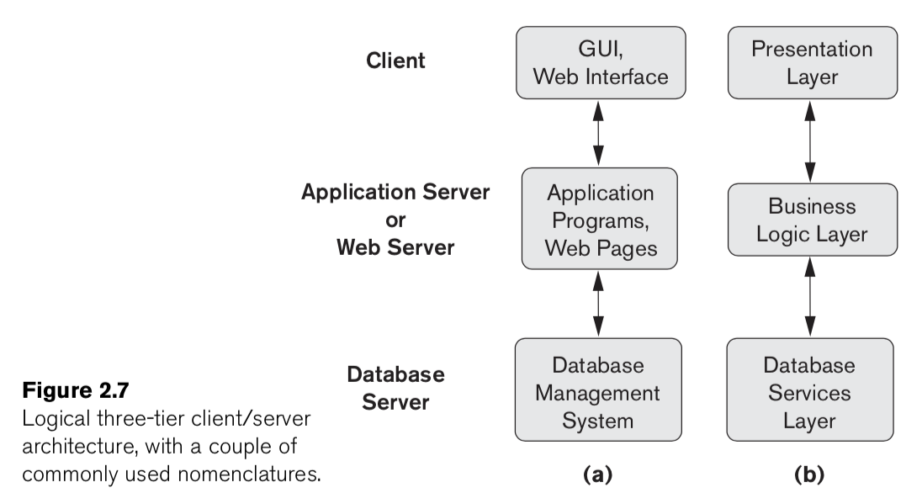
Three-Tier and n-Tier Architectures for Web Applications (cont'd.)
Notes:
e. g. Apache, is free and open-source cross-platform web server software
Or Internet Information Services(IIS) for windows server created by Microsoft

Slide 38
Classification of Database
Management Systems
Data model
  Relational: uses tables, relationships, and columns
  Object: uses Objects, instance, and inheritance (OOP)
  Hierarchical and network (legacy), which organizes data in a tree-like structure
  Native XML DBMS is used to store huge amount of information in the XML format.
Number of users
  Single-user
  Multiuser

Slide 39
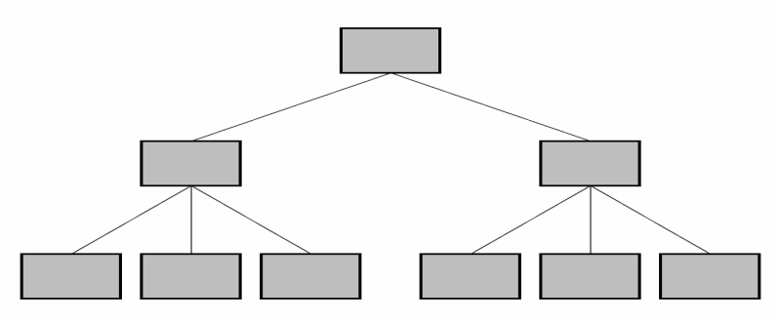
Classification of Database
Management Systems (cont'd.)
Hierarchical and network Model
  A hierarchical data model is a data model which the data is organized into a tree-like structure. The structure allows repeating information using parent/child relationships each parent can have many children but each child only has one parent.
Notes:
Hierarchical and network Model

Slide 40
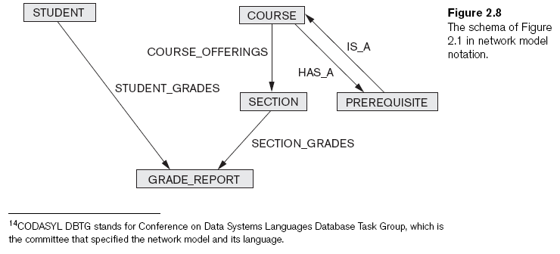
Classification of Database
Management Systems (cont'd.)
Notes:
The schema of Figure 2.1 in network model notation

Slide 41
Classification of Database
Management Systems (cont'd.)
Number of sites
  Centralized
  Distributed
Cost
  Open source
  Different types of licensing

Slide 42
Classification of Database
Management Systems (cont'd.)
General or special-purpose
  When performance is a primary consideration, a special-purpose DBMS can be designed and built for a specific application; such a system cannot be used for other applications without major changes.
  Many airline reservations and telephone directory systems developed in the past are special-purpose DBMSs. These fall into the category of online transaction processing (OLTP) systems, which must support a large number of concurrent transactions without imposing excessive delays.

Slide 43
Summary
Concepts used in database systems
Main categories of data models
Types of languages supported by DMBSs
Interfaces provided by the DBMS
DBMS classification criteria:
  Data model, number of users, number of sties, access paths, cost

